Slide 1
College of Science and Engineering Technology* (COSET)
2016 State of the College Address
*New name effective Sept. 1 2016

Slide 2
Overview
Dean’s Office Introductions
Departmental New Faculty and Staff Introductions
Presentation of College Awards
Recognition of Tenure and Promotion
Year in Review
  Enrollment and Teaching
  Research and Scholarship
  Service
Review of Goals for 2015-2016
Goals for 2016-2017

Slide 3
Office of the Dean
Dean-Dr. John Pascarella
Associate Dean of Curriculum and Assessment
  Dr. Marcus Gillespie
Associate Dean of Research and Graduate Programs
  Dr. Anne Gaillard
Assistant to the Dean-Angie Burgess
Senior Administrative Assistant-Rhonda Baxter
Administrative Assistant-Shellie Armstrong
Staff Assistant- Susan Floyd

Slide 4
College Staff Associates from DELTA
DELTA COSET Web Content Specialist-John Holder (jmholder@shsu.edu)

Slide 5
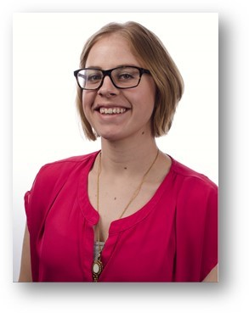
DELTA ONLINE COURSE DESIGN ASSISTANCE
Kaitlyn McGuire
kjs027@shsu.edu
936.202.5037

Slide 6
New Faculty and Staff
Agricultural Sciences and Engineering Technology
Biological Sciences
Chemistry
Computer Science
Geography and Geology
Mathematics and Statistics
Physics

Slide 7
College of Science & Engineering Technology Excellence Awards
Please join me in congratulating the winners:
Graduate Student Excellence in Research – Mrs. Damilola Omotajo (Biological Sciences)
Student Excellence in Teaching – Mr. Kenneth Barnes and Mr. Kyle Laqua (Agricultural Sciences and Engineering Technology)
Adjunct Faculty Excellence in Teaching – Mrs. Sonia Yung (Biological Sciences) and Marsha Wilson (Agricultural Sciences and Engineering Technology)
Faculty Excellence in Research – Dr. Qingzhong “Frank” Liu (Computer Science)
Faculty Excellence in Teaching – Dr. Marcy Beverly (Agricultural Sciences and Engineering Technology)
Faculty Excellence in Service – Dr. Darren Williams (Chemistry)

Slide 8
Faculty Tenure and Promotion
Tenure and Promotion to Associate Professor
  Qingzhong “Frank” Liu (Computer Science)
  Karpoor Shashidar (Computer Science)
  Gary Acton (Geography and Geology)
  Falguni Mukherjee (Geography and Geology)
  Ed Swim (Mathematics and Statistics)
Promotion to Professor
  Patrick Lewis (Biological Sciences)
  Todd Primm (Biological Sciences)
  Darren Williams (Chemistry)

Slide 9
Retirements
Ms. Tammy Gray (31 years), Dean’s Office
Dr. Rick White (32 years), Chemistry
Dr. Jack Turner (36 years), Biology
Dr. Jim DeShaw (46 years), Biology (January 2017)
Thank you for your 145 years of service to SHSU!
We wish you the best in your retirement!

Slide 10
Enrollment and Credit Hours
University enrollment expected to be up around 2%

Slide 11
Undergraduates in COSET
Data as of 8/18/2016-compared to 2015 and 2014
Sciences 3425/2992/4121, up 15% over last year
General Studies* 93/75/66
Interdisciplinary Ag 86/86/66
Agricultural Engineering Tech 86/78/67
Physics 78/90/101
Geography 54/58/72
Elec. And Computer Eng. Tech 53/29/1
Computer Software ET 51/0/0
Plant and Soil Science 40/37/31
Design/Development 32/35/39
Agricultural Communications 25/20/12
Composite Science 2/?/?
Animal Science 453/379/350
Biology 441/514/654
Forensic Chemistry 306/274/302
Computing Science 279/260/289
Agricultural Business 224/211/226
Biomedical Sciences 203/87/79
Construction Management 202/152/121
Mathematics 154/128/125
Applied Arts and Sciences 141/139/164
General Core 122/98/181
Chemistry 103/111/113
Engineering Technology 98/83/79
Geology 97/131/138
*General Studies moving to CHSS

Slide 12
Graduate Students in COSET
Data as of 8/18/2016 , compared to 2015 and 2014, up 1% over last year
Masters 233/228/218
Agriculture 39/49/33
Sustainable Agriculture 24/0/0
Biology 36/30/23
Chemistry 11/17/19
Computing and Information Science 21/27/25
Digital Forensics 23/16/18
Geographic Information Systems 17/20/26
Information Assurance and Security 30/25/31
Mathematics 15/23/24
Statistics 17/14/19
Graduate Certificate 13/7/4
Cyber Security 5/1/0
Data Assurance 1/2/0
Digital Investigation 5/1/3
Geographic Information Systems 2/3/1

Slide 13
SCH-Fall 2016 to Fall 2015
Data from 8/18/2015 , class day -7
Academic Affairs | 3,331 | 2,699 | 632 | 23.42%
Business Administration | 36,331 | 34,988 | 1,343 | 3.84%
Criminal Justice | 22,735 | 22,987 | -252 | -1.10%
Education | 19,741 | 20,632 | -891 | -4.32%
Fine Arts and Mass Comm. | 18,807 | 17,557 | 1,250 | 7.12%
Health Sciences | 18,617 | 12,393 | 6,224 | 50.22%
Humanities and Social Sciences | 62,602 | 65,922 | -3,320 | -5.04%
Sciences | 53,806 | 51,494 | 2,312 | 4.49%
Grand Total | 235,970 | 228,672 | 7,298 | 3.19%
23% of all credit hours come from COS

Slide 14
COSET Graduates
 | Fall 2015/ Fall 2014 | Spring 2016/ Spring 2015 | Summer 2016/ Summer 2015
Undergraduate | 166/177 | 212/243 | 97/94
Graduate | 26/22 | 43/44 | 25/24
Total | 192/199 | 255/287 | 122/118
Total graduates down 5.8% over previous year.
Undergraduate down 7.5%
Graduates up 1%

Slide 15
Teaching and Curriculum
Curriculum and Degree Programs
  TSUS approved:
    PHD in Digital and Cyber Forensic Science, currently at THECB for review
  THECB approved:
    Online Master of Agriculture degree in Sustainable Agriculture and Food Environment (SAFE)
    BS in Digital Forensics Engineering Technology
    Change in Hours for Forensic Chemistry and Composite Science

Slide 16
Teaching Excellence Awards
Office of Graduate Studies 2015-2016
Outstanding Teaching Assistant Award
  Faith Byrd, master’s student in biology;
  Lochana Kanishka Palayagoda, master’s student in statistics;
  Osama Qureshi, master’s student in biology.

Slide 17
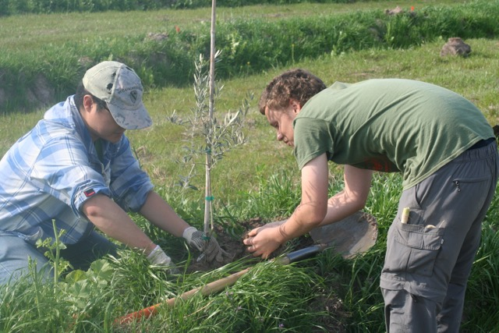
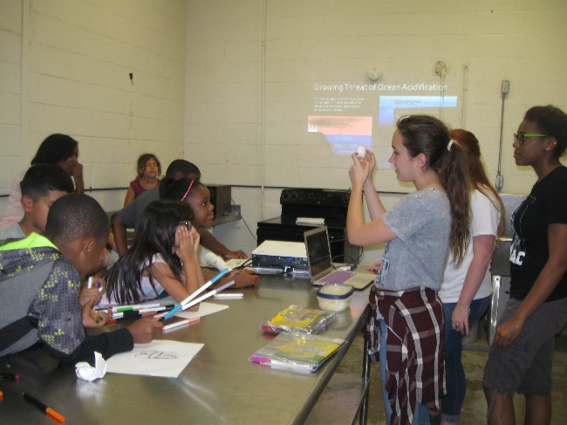

Academic Community Engagement (ACE)
Diane Neudorf
Dept. Biological Sciences
ACE Coordinator for COS

Slide 18
How do I ACE my course?
Simple online form
Connect ACE project to course objective
Include ACE reflection assignment
Must be part of grade (not optional)
Students work on project 9 hours outside of class (for 3 credit class)
Find a community partner
Need help? Neudorf@shsu.edu

Slide 19
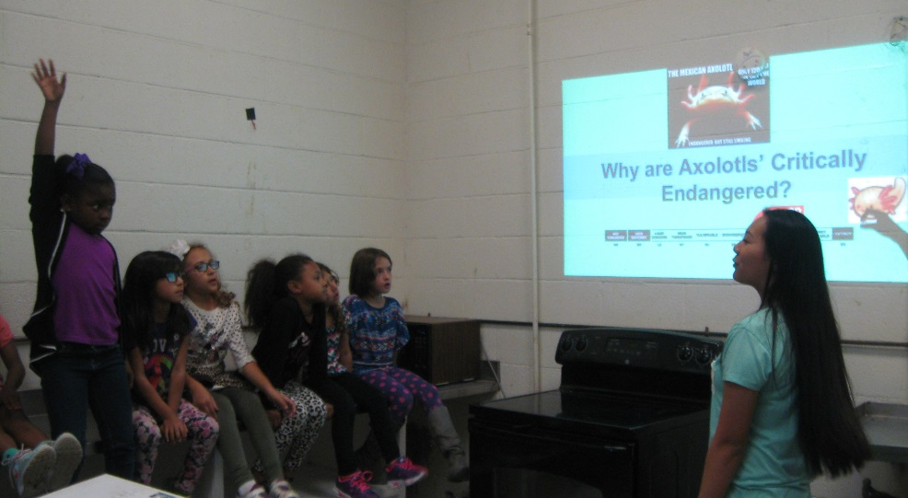
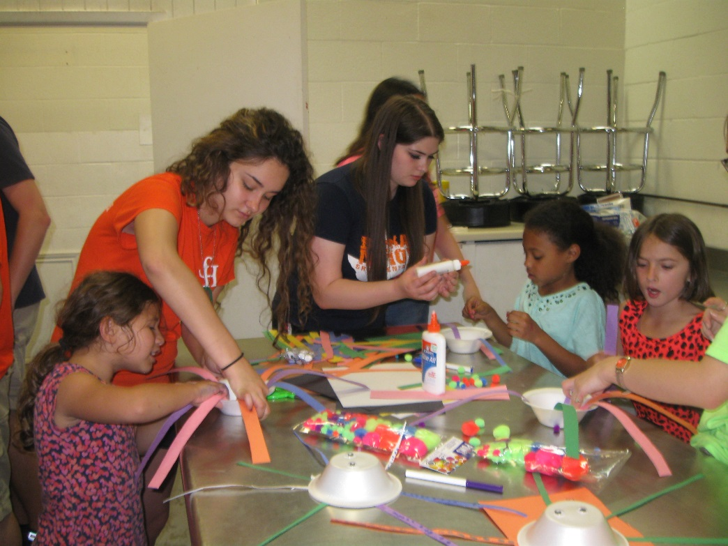
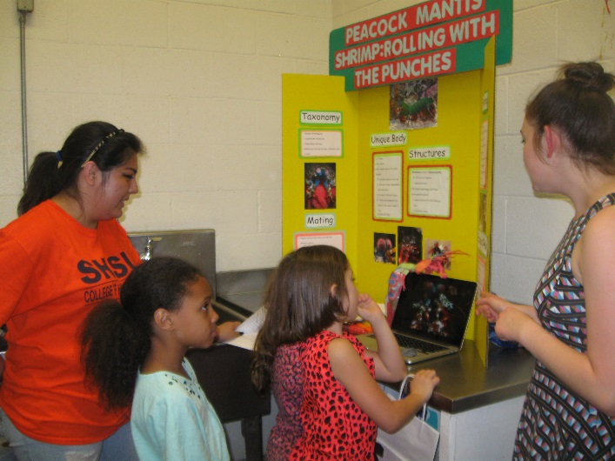
Neudorf - BIOL 1413 Honors Zoology
Partner: Boys and Girls Club
Topic: Weird Animals
Presentation, craft and activity

Slide 20
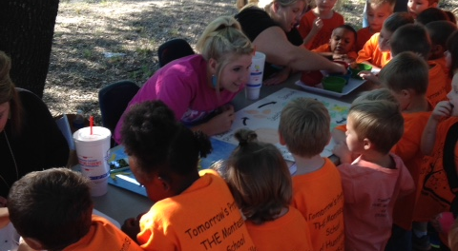
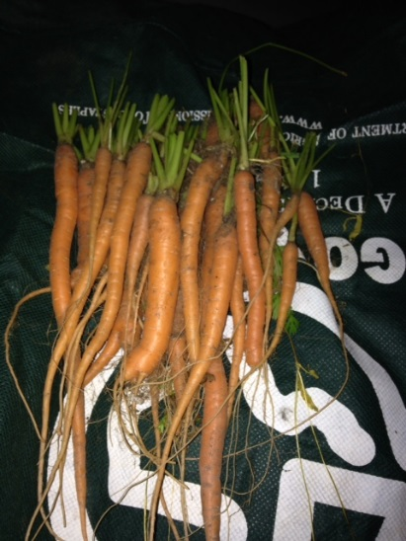
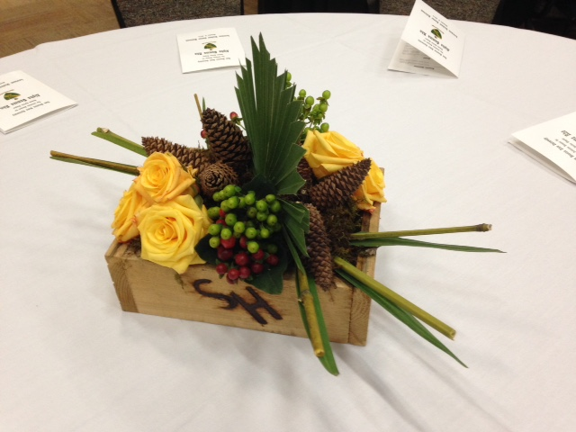
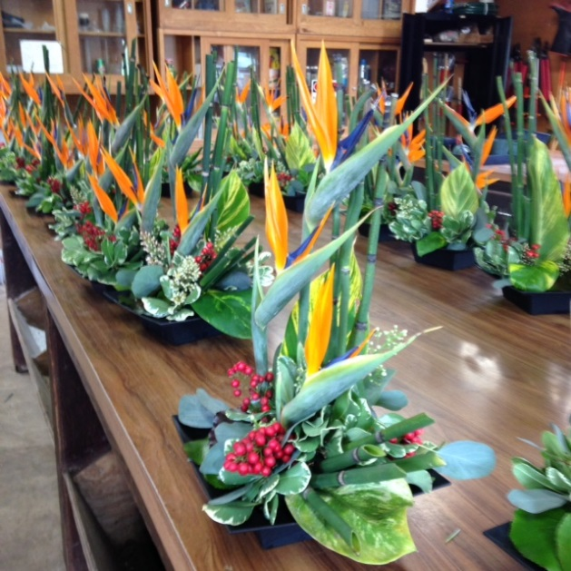
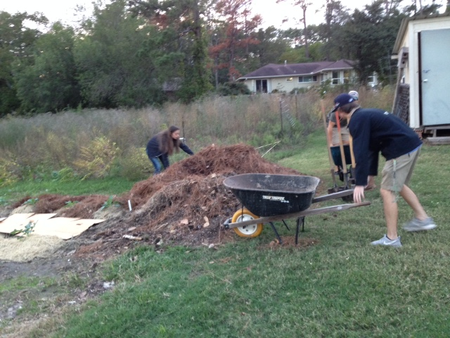
S. Frey – PLSC 1307 Plant Science/PLSC 2399 Floral Design
Partners: local schools, Good Shepherd Mission, SHSU
Projects: Community gardens, Barnyard Green Thumb, Centerpieces for SHSU events

Slide 21
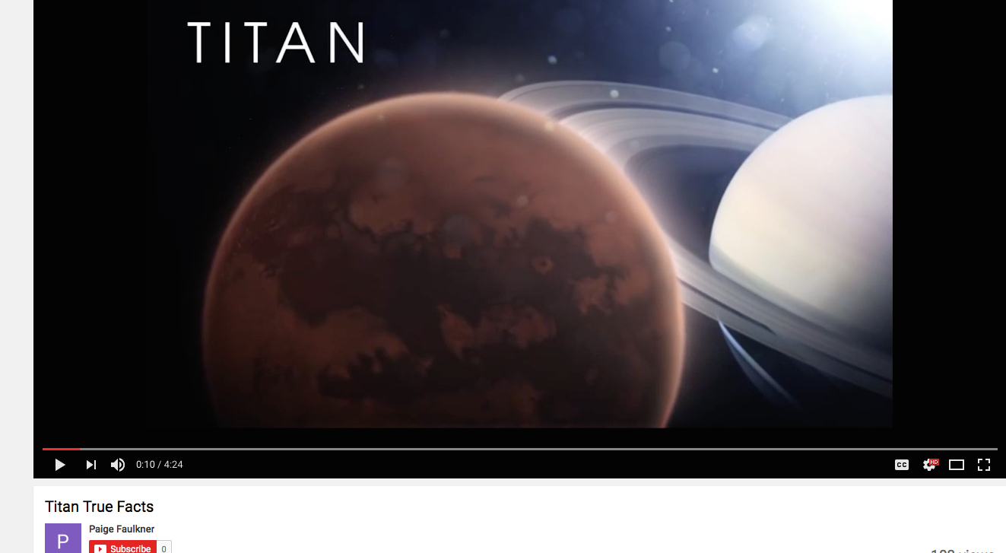
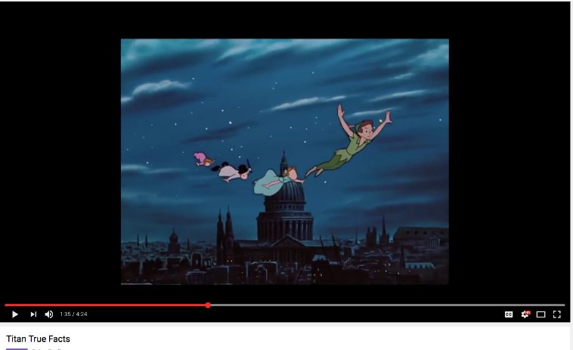
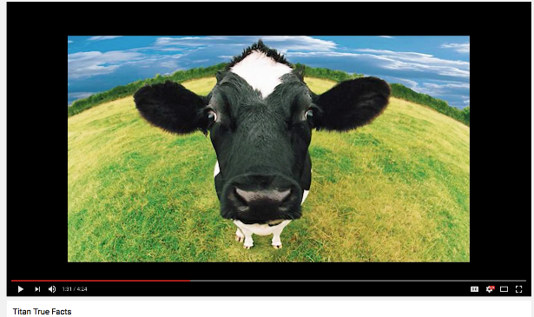
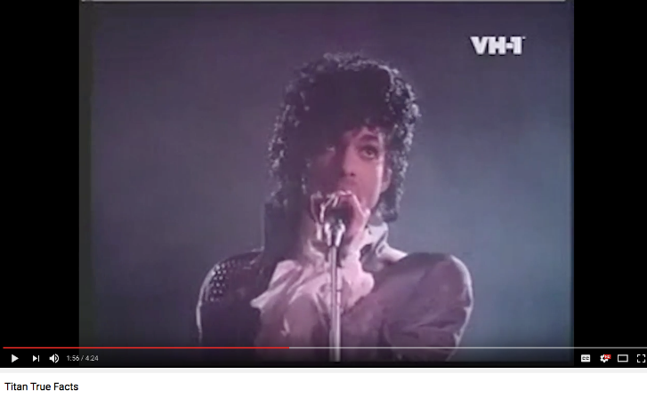
R. James – Phys 1404 – Solar System Astronomy
Partners: local middle and high schools
Activity: Create a “The True Facts About …” style video
https://www.youtube.com/watch?v=u-SilcZF748
Coming Summer 2017: New ACE class - Traveling Astronomy

Slide 22
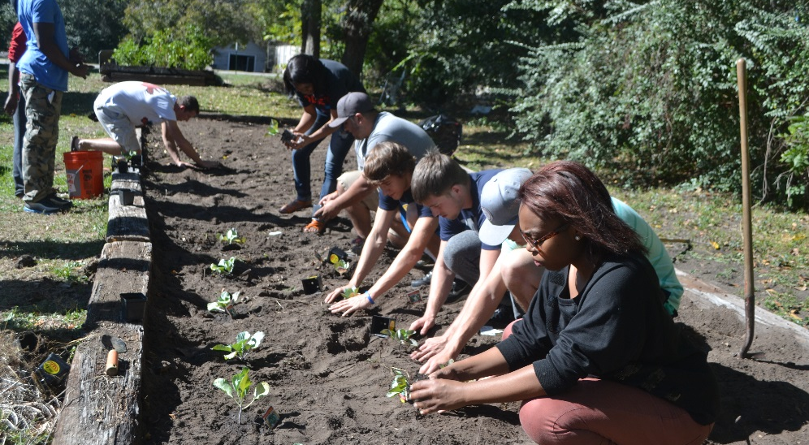
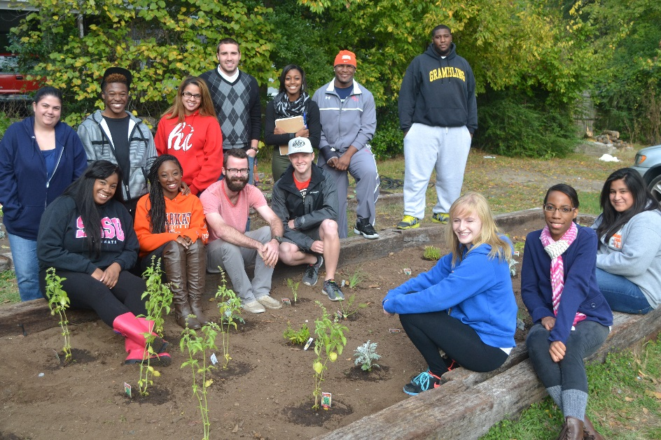
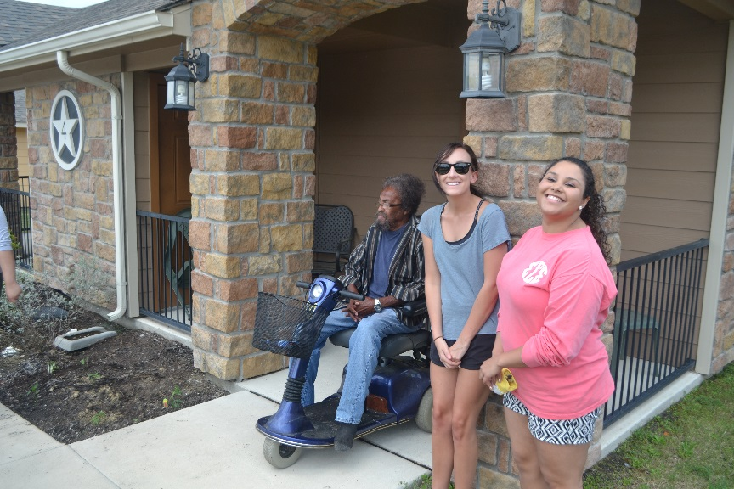
J. Wozniak – BIOL 1401 – Env. Science
Partners: Good Shepherd Mission, the Villages, SHSU
Projects: Community gardens, recycling

Slide 23
Why should I ACE my class?
Connect university with community
Improves learning
Students gain a spirit of volunteerism
Students are more marketable
Opportunities for faculty scholarship

Slide 24
But….
My class is too big.
It will take too much time.
Students won’t want to do the work.
I teach an (online, majors, non-majors, grad, summer, etc.) class.

Slide 25
Cumulative ACE classes in COS
 | 2010 | 2011 | 2012 | 2013 | 2014 | 2015 | 2016
Ag. Sci & Engineer | 0 | 2 | 2 | 6 | 7 | 8 | 8
Biol. Sci. | 0 | 0 | 1 | 2 | 2 | 5 | 8
Chemistry | 0 | 1 | 1 | 1 | 1 | 0 | 0
Comp. Sci. | 1 | 1 | 3 | 5 | 5 | 7 | 8
Geog. /Geol. | 0 | 0 | 0 | 0 | 0 | 0 | 0
Math/Stat | 0 | 0 | 0 | 0 | 1 | 1 | 1
Physics | 0 | 0 | 0 | 0 | 0 | 1 | 1
Totals | 1 | 4 | 7 | 14 | 16 | 22 | 26

Slide 26
Number of ACE Courses By College
College | 2015
Business Administration | 12
Criminal Justice | 27
Education | 115
Fine Arts and Mass Communication | 30
Health Sciences | 27
Humanities and Social Sciences | 41
Science and Engineering Tech. | 22

Slide 27
Program Dignity
Dignity
A sense of pride in oneself; self respect
An individual’s sense of self-respect and self-worth, physical and psychological integrity, and empowerment.
Program Dignity will be comprised of several projects which have the common goal of providing service to the community, both local and international, with an initial emphasis on providing prosthetic devices and assistance to amputees.
Notes:
I changed PROJECT to PROGRAM to keep it consistent…unless we change the whole name.
I eliminated: Develop and produce prosthetic limbs and devices for the physically impaired at the Center for Innovation and Technology. This is really a ”PROJECT” UNDER THE PROGRAM DIGNITY, RIGHT?
SO…I ADDED THE NEXT SLIDE.

Slide 28
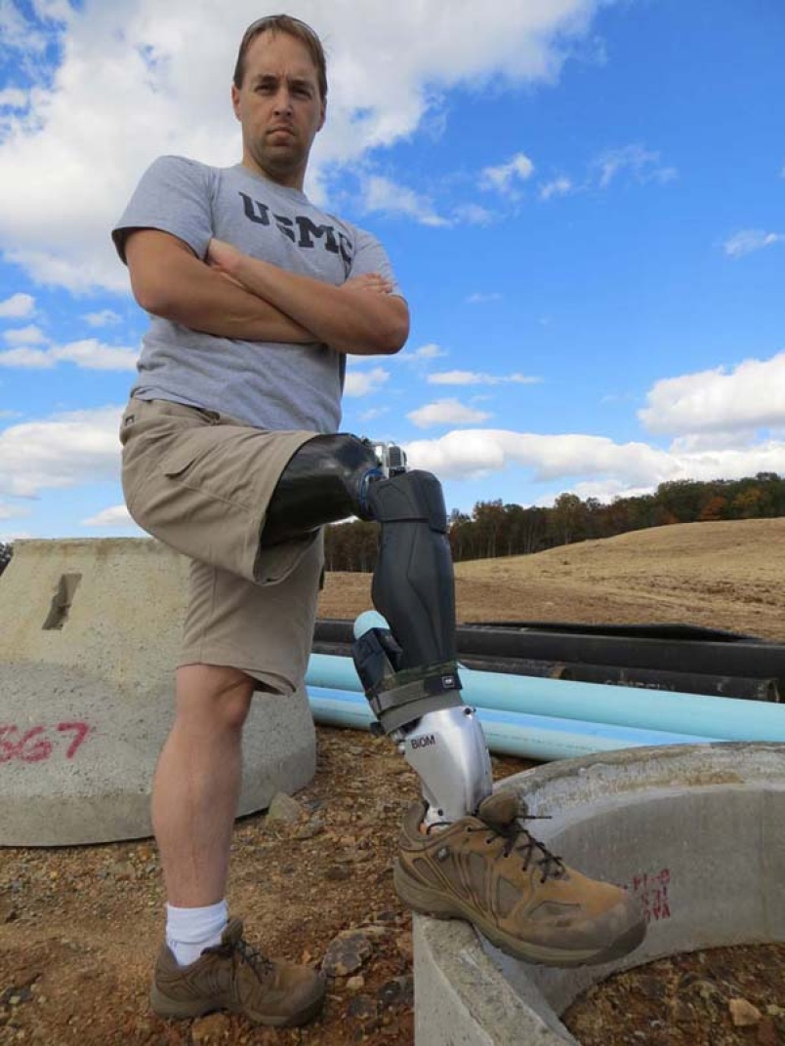

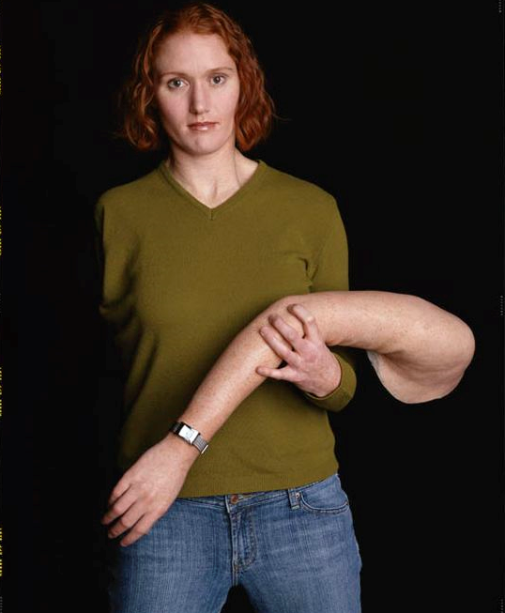
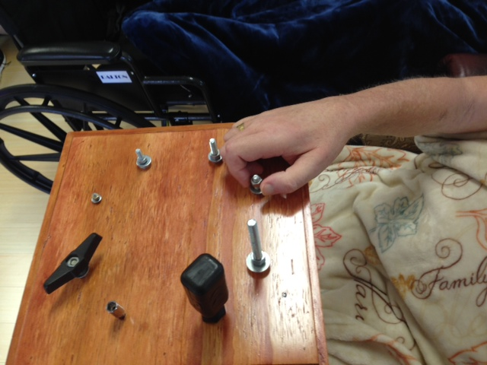
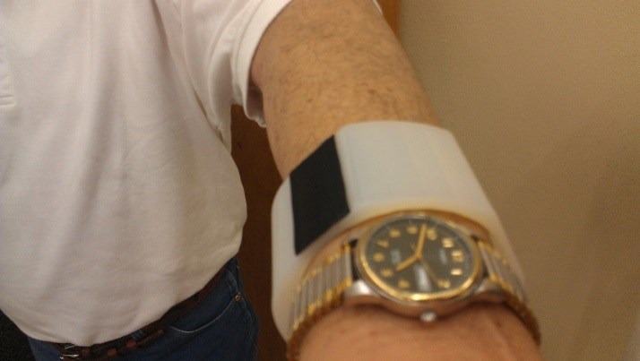
Project Intrepid
Notes:
I changed PROJECT to PROGRAM to keep it consistent…unless we change the whole name.

Slide 29
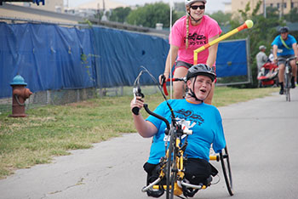

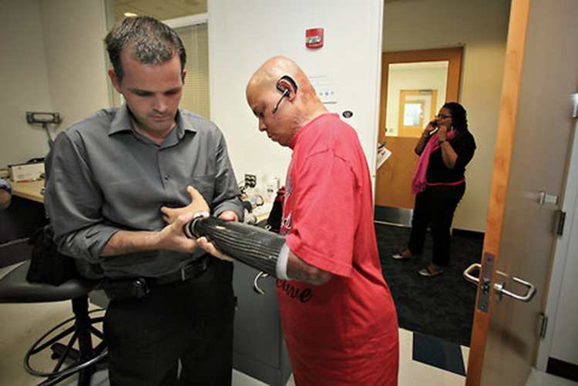
Project Intrepid
Supports Wounded Soldiers at the Center for the Intrepid
At Fort Sam Houston in San Antonio
The threefold mission of the CFI is to provide rehabilitation for OIF/OEF casualties who have sustained amputation, burns, or functional limb loss, to provide education to DoD and Department of Veteran's Affairs professionals on cutting edge rehabilitation modalities, and to promote research in the fields of orthopedics, prosthetics and physical/occupational rehabilitation. The goal is to assist patients as they return to the highest levels of physical, psychological and emotional function.

Slide 30
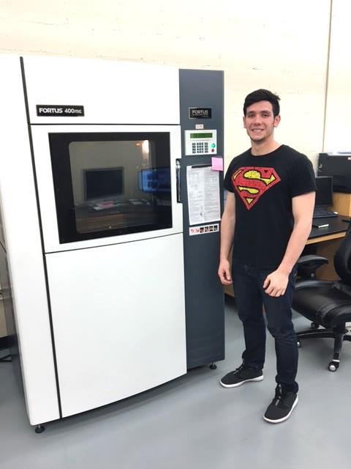
Printed using 3D printers in the Center for Innovation and Technology

Slide 31
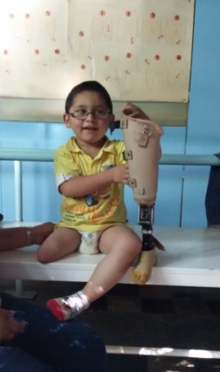
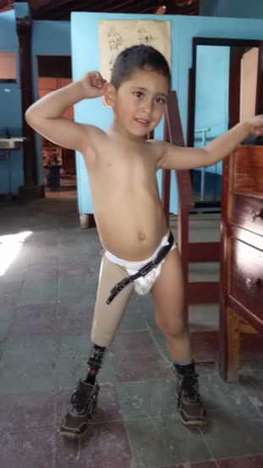
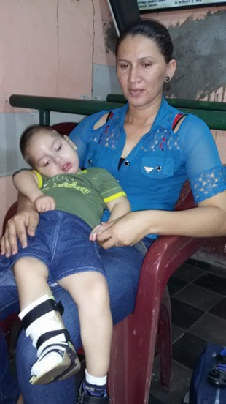
Project Nicaragua (Rotary Connection)
The Fundación para la Rehabilitación Walking Unidos (FURWUS) - originally founded in 1998 as a prosthetic outreach center in Leon, providing artificial limbs to Nicaragua’s poorest. Over the past 16 years, FURWUS has become one of the major grassroots rehabilitation organizations in Central America. FURWUS provides custom mobility devices (orthoses, prostheses, and wheelchairs) to ensure that people are able to become active, contributing members of their communities. “FURWUS and its three prosthetic outreach clinics and economic integration program represent one of the most important locally-owned and operated civil society organizations present in Central America today” (USAID). Also supported by the Inter-American Foundation.
Notes:
http://www.iaf.gov/resources/publications/annual-reports/2004/nicaragua

Slide 32
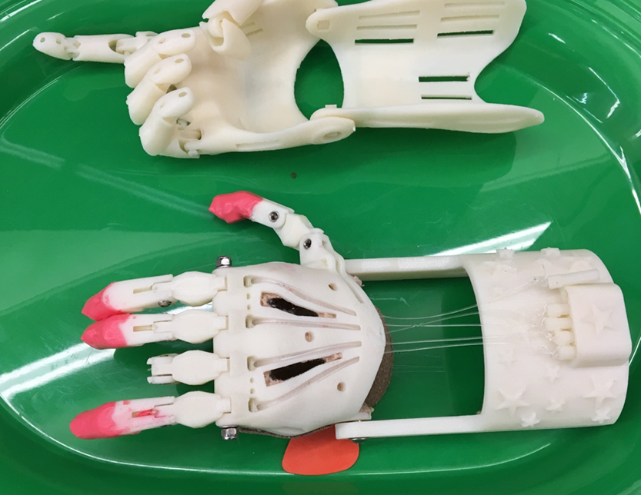
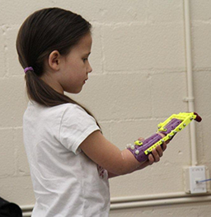
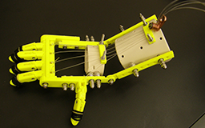
Project Robohand
(for Zoe and other children with amniotic band syndrome (ABS)
The hand is being produced using open source files from a website called MakerBot Thingiverse. The Robohand has been designed by other organizations for children with ABS and CIT produces it using open source files.
The Robohand is not a replacement for a prosthetic, but rather a tool for Zoe to use until she reaches an age where a prosthetic might be feasible.
Notes:
Note: the star symbol indicates a video link

Slide 33
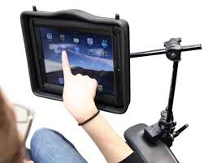
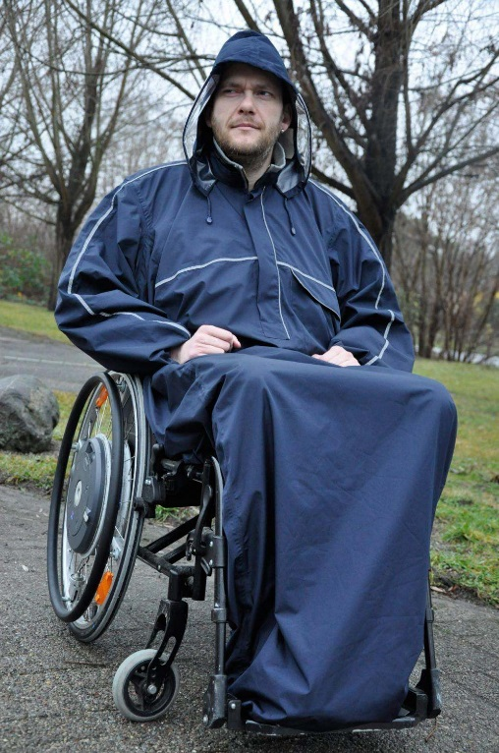
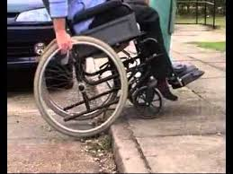
Project Saddlebag:
Design and produce devices for SHSU students and others who are physically impaired.

Slide 34
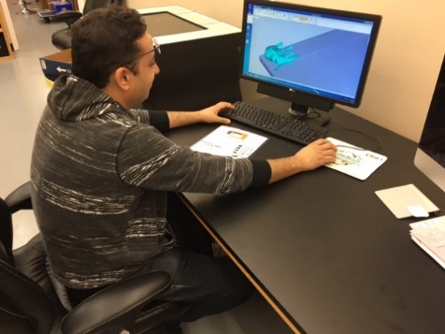
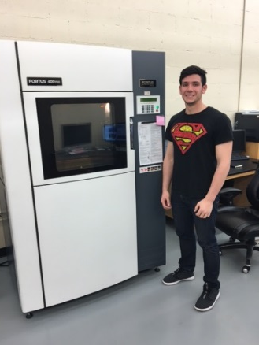
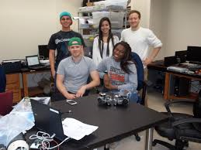
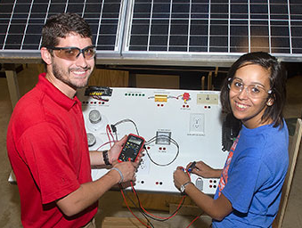
SHSU: Program Dignity will enable the university to create internship and ACE opportunities for students and faculty, and build interdepartmental cooperation.
Chemistry
Engineering Technology
Computer Science
Center for Innovation and Technology
Technical writing -
patents
Project management
Graphic design
Biomedical Science
Nursing/Kinesiology/ Rehab

Slide 35

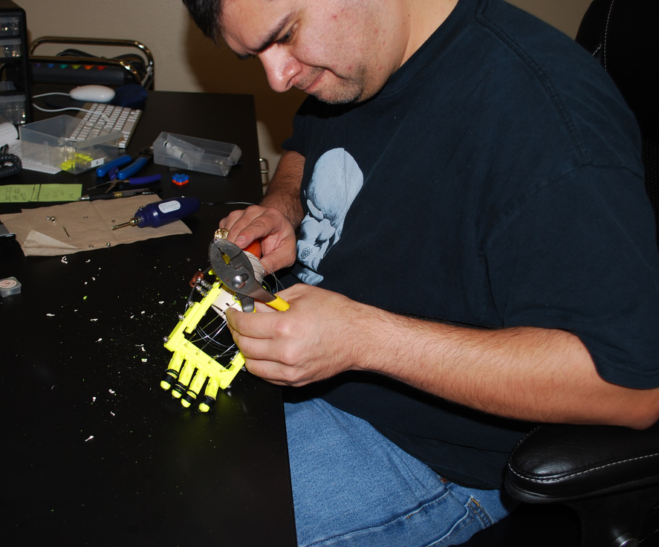
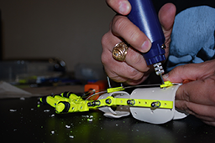
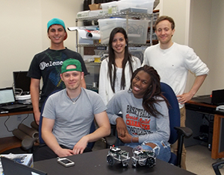
Students, working as interns or participating in ACE classes would design and produce the prosthetics. In both cases, it would be part of the standard coursework requirements.
Ensures long-term commitment to Program Dignity
Ensures quality – students have vested interest in doing well

Slide 36


Possible Program Dignity projects not dependent upon technology
Not all injuries can be seen...
Notes:
more than 155,000 American active-duty and veteran men and women suffer from PTSD.

Slide 37
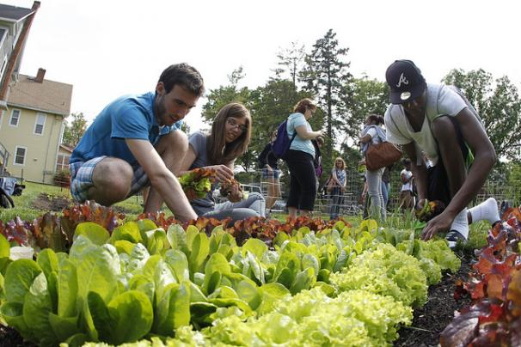
Community gardens – donate food

Slide 38
Sam Houston State would be more likely to be awarded national recognitions:
Carnegie Classification for Engaged Campus
The President’s Higher Education Community Service Honor Roll
The Higher Education Civic Engagement Award (Washington Center)
Notes:
I added this slide

Slide 39

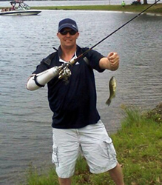
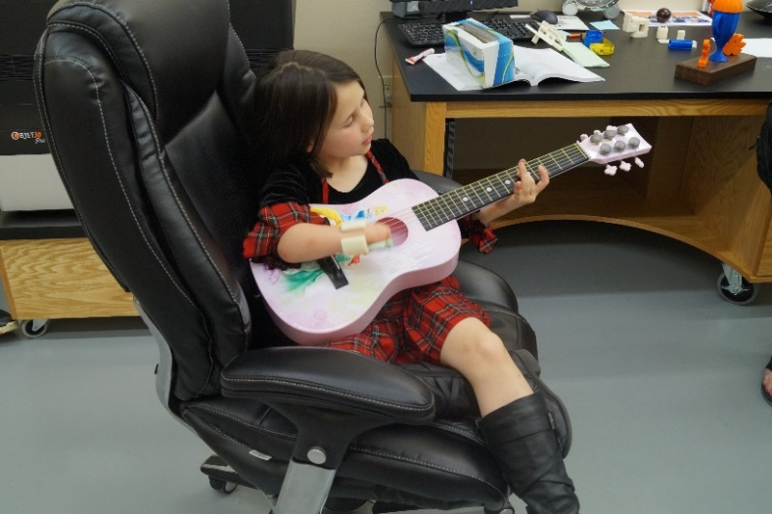
Program Dignity can provide many types of community service, including low cost prosthetics and devices, and many forms of outreach to assist those in need.
It’s the right thing to do!

Slide 40
Research and Scholarship

Slide 41
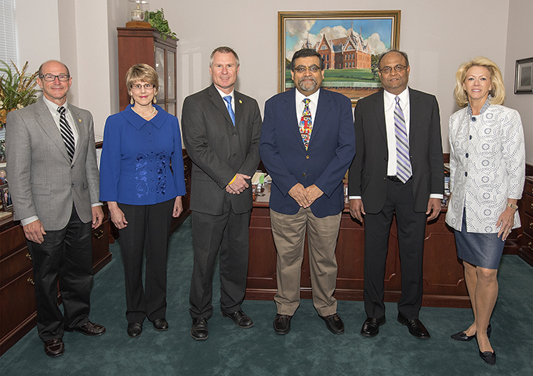
SHSU Award of Excellence in Scholarly and Artistic Accomplishment
Dr. Madhusudan Choudhary (Biological Sciences)

Slide 42
Office of Graduate Studies Awards
Master’s student in computer science Luke Voigt was presented with the Capstone Award for his project “Creating Actionable Information From Raw Data: Securing The Network Of Small to Medium Size Enterprises.”
The Thesis Award was presented to Chemistry student Harshani Jayabahu Arachchilage for “Synthesis and Structural Characterization of (μ-OXO)(μ-modified benzoate)diiron(III)tris(2-pyridylmethyl)amine Complexes.”

Slide 43
Faculty Research Grant ($5,000): 5 out of the 10 awards were to COSET faculty
Chad Hargrave and Carmen Montana (Biological Sciences)-”Food Web Connectivity in a Tropical Floodplain River”
Umit Karabiyik (Computer Science)-”Digital Forensics Tools Raking with Multi-Armed Bandit Problem”
Gan Liang (Physics)-”Cathode Materials for Next Generation Lithium-Ion Batteries”
Velvet Nelson (Geography and Geology)-”Engaging with Slavery at Sam Houston Memorial Museum”
Min Jae Suh (Agricultural Sciences and Engineering Technology)-”Training and Education for Green Construction in Texas”
Deadline to apply is October 10, 2016

Slide 44
Enhancement Research Grants ($15,000):
4 of the 10 awards were to COSET Faculty
Brandy Doleshal (Mathematics and Statistics)-”Primitive Seifert Twisted Torus Knots”
Aaron Lynne and Patrick Lewis (Biological Sciences)- “Microbiome of Bone for Determining PMI”
Donggil Song (Computer Science) and Marilyn Rice (Curricum and Instruction): “Developing an Intelligent Agent for Interaction in Online Courses”
Bing Zhou and Hyuk Cho (Computer Science): “Robust Sensor Data Fusion Through Adaptive Threshold Learning”
Deadline to apply is October 3, 2016

Slide 45
Professional Development Leaves for FY17
Funded by the Provost
Dr. Dustin Jones (Mathematics and Statistics)

Slide 46
COSET Dean’s Office Funding for Research
Provided $85,000 in additional funding to EURECA for student-faculty summer research teams (FAST)
Funded undergraduate students through COSET Undergraduate Research Program ($15,000) in our fall and spring competition
Funded Summer NSF Math REU expenses ($22,000)
Funded Faculty and Student Publications and Travel ($54,000)
Provided 16 summer stipends for graduate student thesis research ($50,000)

Slide 47
External Funding (7/1/15-7/1/16)
Department | # New Apps | $ New Apps | # Grants Awarded | $ New Awards | # Active Awards | $ spent active grants
Agricultural Sciences and Engineering Technology | 10 | $2,626,744 | 1 | $126,257 | 4 | $133,204
Biology | 10 | $768,251 | 5 | $68,146 | 8 | $287,317
Chemistry | 1 | $80,000 | 2 | $95,000 | 4 | $253,711
Computer Science | 3 | $1,279,650 | 0 | $0 | 1 | $63,297
Geography/Geology | 4 | $118,413 | 1 | $10,000 | 2 | $19,694
Math and Statistics | 6 | $4,702,218 | 3 | $185,561 | 7 | $361,011
Physics | 2 | $228,535 | 1 | $75,000 | 2 | $20,891
Total | 36 | $9,803,811 | 13 | $559,964 | 28 | $1,139,127
Last Year | 22 | $4,570,233 | 19 | $468,468 | 22 | $1,274,132

Slide 48
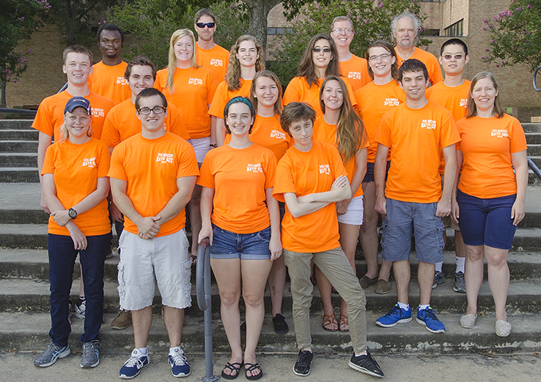
Selected Awards and Active Grants 2014-2015
New Grants
Agricultural Sciences-New collaborative grant with MTSU to Dr. Nair on remote sensing in agriculture
Biological Sciences – Continued Earthwatch funding to Dr. Wozniak, new grants to Dr. Lynn and Dr. Harper
Chemistry-Continued Army funding of Dr. Petrikovics on cyanide antidotes, Dustin Gross-New grant from American Chemical Society, Welch Grant
Geography-Historical Research grant to Dr. Tiller
  Math and Statistics-3nd year of NSF REU at SHSU, Math Academy at Sam Houston (Dr. Jones)
  Physics-New NSF grant to Joel Walker

Slide 49
Scholarship
Dr. Dusty Jones co-authored book “Putting essential understanding of geometry and measurement into practice in grades 3-5”
Dr. Jianzhong Wang submitted 8-peer reviewed articles
Dr. Ken Smith solved a long-standing problem in Hadamard Difference Sets
Drs. Sibyl Bucheli and Aaron Lynne published a paper in “Science”
Dr. Juan Daza published a paper in “Science Advances”
Chemistry faculty published 8 peer-reviewed articles and had 25 presentations

Slide 50
SERVICE

Slide 51
SHSU Faculty Excellence in Service Awards
Dwayne Pavelock (Agricultural Sciences and Engineering Technology)

Slide 52
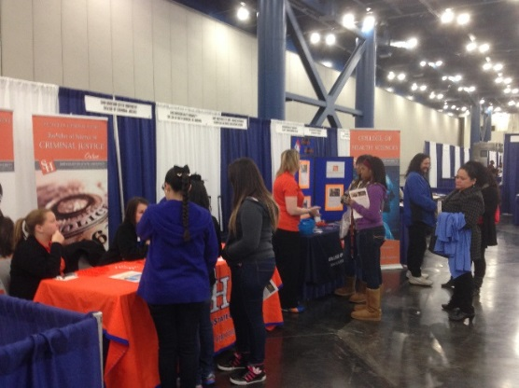
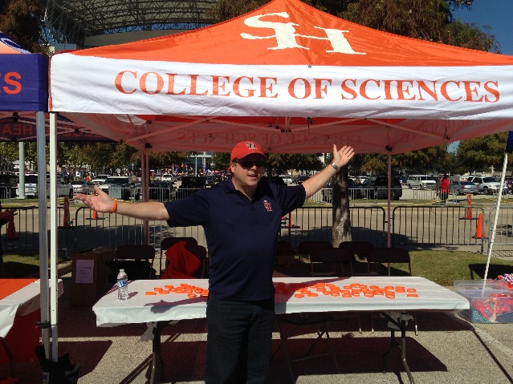
Service Activities from Dean’s Office
Dean’s Office and Biology Faculty attended “Houston Hispanic Forum” and Lone Star College recruiting events
Organized Annual College Career Fair
Served on Faculty Compensation Committee
Chaired the Dean of Graduate Studies Search Committee
Served on Promotion and Tenure Policy Review Committee
Served on Let’s Talk Fundraiser for Honors College
Supported College of Sciences Tailgate at Football Games
Served on Search Committee for Vivarium Technician
Supported Operation Math Girls outreach program
Provided funding for Undergraduate Research Day

Slide 53
COSET Faculty in Administration
Dr. Jerry Cook (Biology), Associate VP of Research
Dr. Tamara Cook (Biology), Director of EURECA
Dr. Patrick Lewis (Biology), Assistant Director of Honors Program
Dr. Bill Lutterschmidt (Biology), Director of University Research Centers
Dr. Diane Neudorf (Biology), ACE coordinator for COS
Dr. Todd Prim (Biology), Interim Director of PACE

Slide 54
Other Service Contributions
Dr. Rick White is the co-winner of the DAAD Alumni Association’s Award for International Exchange.
Dr. Alex Mikishev is organizing the conference in the Woodlands on ”Bifurcations and
Instabilities in Fluid Dynamics” July 11-14 2017.
Dr. Melinda Holt elected to the American Statistical Association’s Council of Chapters Governing Board for a 3-year term
Dr. Luis Garcia served as a research director for 2016 Mathematical Sciences Research Institute Undergraduate Program
Dr. Dusty Jones served as President of the Association of Mathematics Teacher Educators in Texas
Biology hosted the Texas Chapter of American Society of Microbiology
Math hosted the “Conference on the Teaching of Mathematics 6-12”

Slide 55
Editorships
Dr. Don Albert serves as editor of the International Journal of Applied Geospatial Research
Dr. Luis Garcia, Associate Editor, American Mathematical Monthly and J. of Algebraic Statistics
Dr. Jianzhong Wang, Associate Editor for International Journal of Applied Analytics and Mathematics and Computer Data Science
Dr. Dusty Jones, Editorial Board, International J. of Ed. Research.
Dr. Chris Randle is Editor-in-Chief of Castanea, the Journal of the Southern Appalachian Botanical Society
Dr. Kyle Stutts and Art Wolfskill serve on Editorial Board – Journal of North American Colleges and Teachers of Agriculture
Dr. David Thompson is Associate Editor for Analytical Sciences Digital Library

Slide 56
Equipment and Infrastructure

Slide 57
Academic Buildings
Sciences Annex (Vivarium-Animal Care Facility) is fully operational, Ed Tivador is the Animal Care Technician
$5 million in renovation work on Lee Drain to be spent over next three fiscal years on deferred maintenance (new flooring, ceiling tiles, exterior work, replace skylight with clerestory roof, mold abatement, etc.)

Slide 58
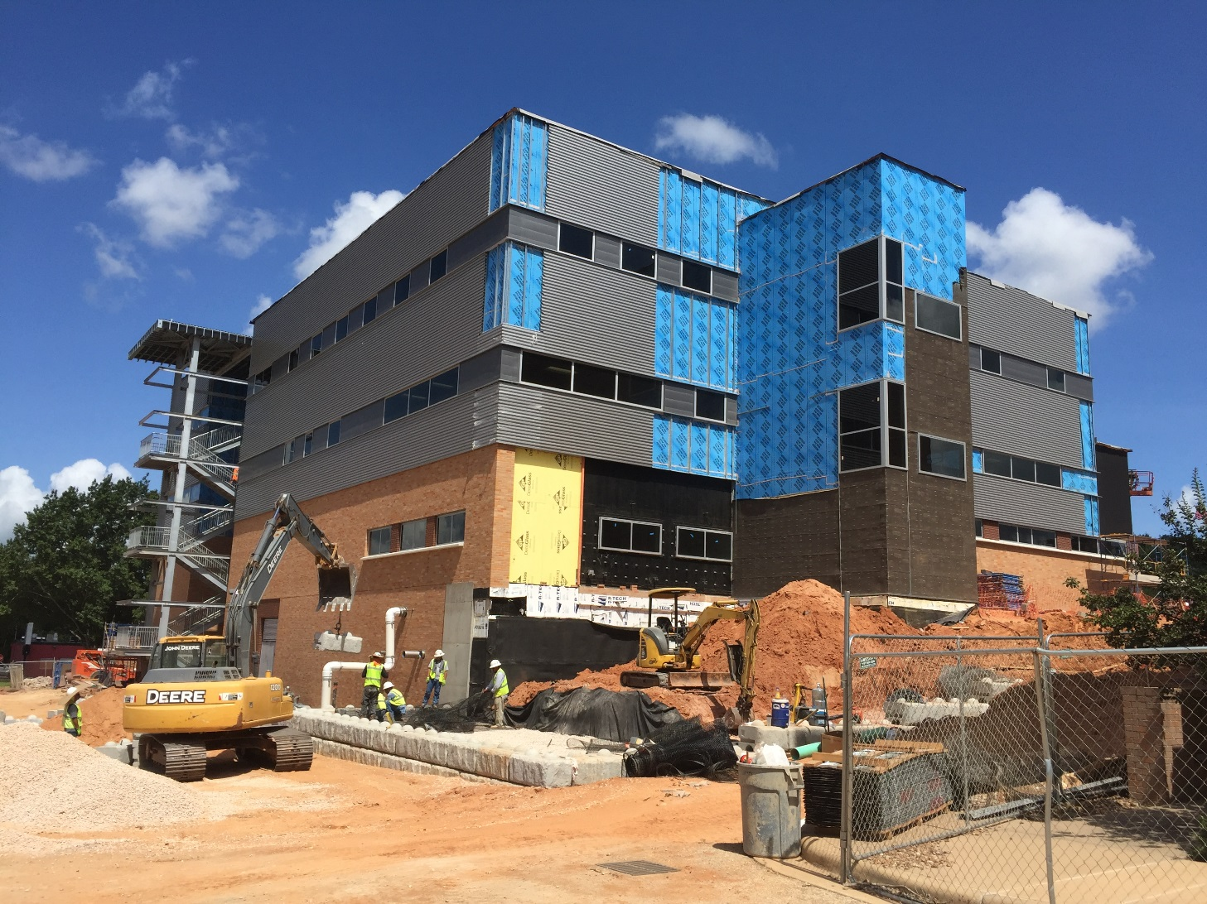
Fred Pirkle Engineering Technology Center-opens Jan. 2017

Slide 59
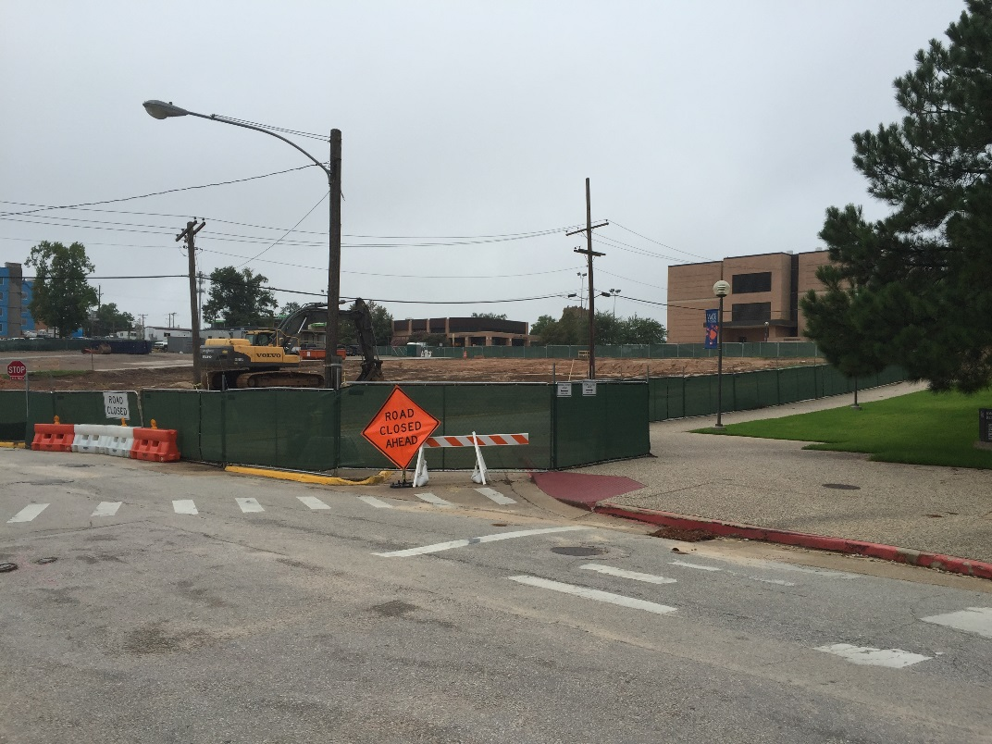

Biology Lab Building
Ground Breaking Ceremony September 7th at 9:30am. Please attend if interested.

Slide 60
Opens Fall 2018

Slide 62
Other Academic Spaces
Allocated permanent space in a first
floor room at The Woodlands Center
for GIS lab.
SHSU Natural History Museum
Collection and teaching space
available for use;
Contact Will Godwin for reservations

Slide 63



CBFS Piney Woods Lab and Classroom
Biological Field Station Piney Woods Lab is now open with lab, lecture hall, and
internet access; Contact Alan Byboth for reservations

Slide 64

New Equipment
Scanning Electron Microscope donated to the Geology department from the Texas Department Of Transportation

Slide 65
Review of Goals for 2015-2016

Slide 66
Goals from last year
Change Name to College of Science and Engineering Technology (COSET); approved by TSUS and THECB, new name starts Sept. 1
Submit Full Proposal for First PhD in College in Digital and Cyber Forensic Science-approved by TSUS, under review by THECB for spring 2018 start
Support Student Research - Provide Summer Research Grants for Graduate students to encourage timely and high quality research; funded 16 stipends summer 2016; funded undergraduate research program, funded FAST grants
Fundraising-Complete Gift for Engineering Technology, Have a $3,000,000 commitment from Quanta Energized Systems for Support for 1-2 Endowed Professors and research support

Slide 67


Goals from last year-continued
Increase International Recruitment and Course Offerings
  Develop proposal with Karz University, Turkey for 2+2 program in Biotechnology/Bioengineering-met but not moving forward
  Zhejiang Police College for Computer Science Digital Forensics 3+1 program; -will visit with them fall 2016 to discuss
  Teach biology field course in Costa Rica-accomplished
  Signed MOU with three universities in Sri Lanka (University of Kalideniya, University of Perideniya, and University of Ruhuna), recruited a Biology student during visit.

Slide 68
Goals for FY17
Obtain THECB approval and internal budget allocation to support PhD program in Digital and Cyber Forensic Science
Successfully move Agricultural Sciences and Engineering Technology into Fred Pirkle Building and hire the first Quanta Endowed Professor of Engineering Technology
Complete Planning for Biological Sciences Building Equipment Needs
Complete Curriculum Proposals for BS in Environmental Science and Revised Curriculum for Composite Science

Slide 69
Have a great year!
Please provide your input into all of these areas through your departmental meetings, department chair, faculty senate representatives, and other venues.

